Slide 1


CCNP SWITCH v7.1
Chapter 9: High Availability

Slide 2
High Availability
The focus of this chapter is:
The need and basic idea behind switch stacking and Virtual Switching System (VSS)
StackWise
The benefits of StackWise
Verifying StackWise
VSS
VSS benefits
Verifying VSS
Supervisor redundancy
Supervisor redundancy modes

Slide 3
The need for High Availability
A network with high availability provides an alternative means that enables constant access to all infrastructure paths and key servers.
High availability (HA) is not just about adding redundant devices.
It implies planning to understand where the points of failure occur and designing the network so that an alternative solution exists to compensate for the loss of these points of failure, especially single point of failures.
HA can be divided into two categories. One is focused on networking devices, and a second one is focused on first-hop gateway redundancy.
In the case of networking devices, redundant topologies often introduce overhead in terms of management, resiliency, and performance.
To reduce the number of logical network devices and simplify Layer 2 and Layer 3 network topology, two switch virtualization technologies: StackWise and Virtual Switching System (VSS).
This chapter also covers supervisor redundancy options such as route processor redundancy (RPR), route processor redundancy plus (RPR+), stateful switchover (SSO), and nonstop forwarding (NSF).

Slide 4
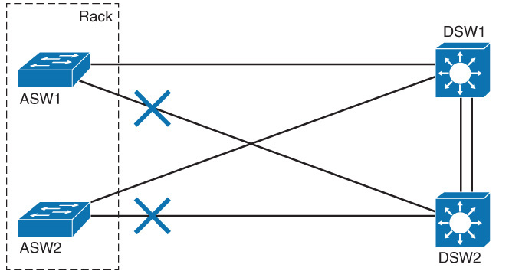
The Need for Logical Switching Architectures
A typical switch topology on the access and the distribution layer may consist of:
Two (or more) access switches are sitting next to each other in the same rack to provide enough access ports for all the network devices, each one with two redundant connections to each of the distribution switches.

Slide 5
The Need for Logical Switching Architectures
This topology introduces certain overhead in terms of management, resiliency, and performance.
Every switch demands its own configuration and management, even though you can clearly identify only two different roles: access and distribution.
Every access switch needs its own uplink to each of the distribution switches to satisfy the redundancy requirements, but one of the uplinks has to be blocked by the Spanning Tree Protocol (STP) to prevent a loop, thus cutting the bandwidth in half. Configuring the Per-VLAN STP (PVSTP) will unequally utilize both uplinks, but with additional management overhead.
Hosts connected to ASW1 can only communicate with hosts in the same VLAN connected to ASW2 via one of the distribution switches.
To overcome some of these limitations, Cisco proposes the following virtualization solutions.
StackWise: Focused on the access layer module
VSS: Focused on the aggregation layer module

Slide 6
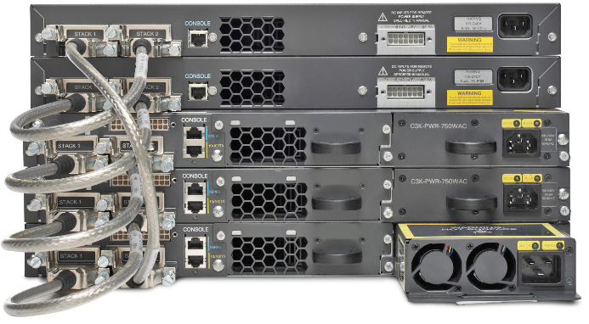
What Is StackWise?
Cisco StackWise technology provides a method for collectively utilizing the capabilities of a stack of switches.
Configuration and routing information is shared by every switch in the stack, creating a single switching unit.
Switches can be added to and deleted from a working stack without affecting performance.

Slide 7
What Is StackWise?
The switches are united into a single logical unit, using special stack interconnect cables that create a bidirectional closed-loop path.
This bidirectional path acts as a switch fabric for all the connected switches.
Network topology and routing information is updated continuously through the stack interconnect.
All stack members have full access to the stack interconnect bandwidth.
The stack is managed as a single unit by a master switch, which is elected from one of the stack member switches.
Up to nine separate switches can be joined.

Slide 8
What Is StackWise?
Each stack of switches has a single IP address and is managed as a single object.
This single IP management applies to activities such as fault detection, VLAN creation and modification, security, and quality of service (QoS) controls.
Each stack has only one configuration file, which is distributed to each member in the stack.
This allows each switch in the stack to share the same network topology, MAC address, and routing information.
In addition, it allows for any member to become the master if the master ever fails.

Slide 9
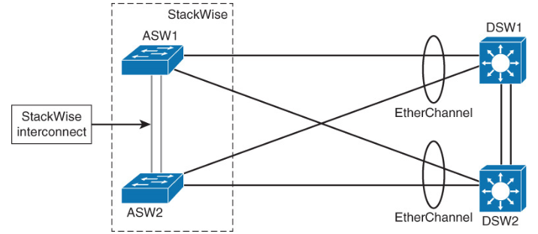
StackWise Benefits
Multiple switches are used to provide enough access ports.
The stack, up to nine switches, is managed as a single unit, reducing the number of units that you have to manage in your network.
Switches can be added to and removed from a working stack without affecting stack performance.
When a new switch is added, the master switch automatically configures the unit with the currently running IOS image and the configuration of the stack.

Slide 10
StackWise Benefits
You do not have to do anything to bring up the switch before it is ready to operate.
The switches are united into a single logical unit using special stack interconnect cables that create a bidirectional closed-loop path.
This bidirectional path acts as a switch fabric for all the connected switches.
When a break is detected in a cable, the traffic is immediately wrapped back across the remaining path to continue forwarding.
Multiple switches in a stack can create an EtherChannel connection.
STP can thus be avoided, doubling the available bandwidth of the existing distribution switches uplinks.

Slide 11
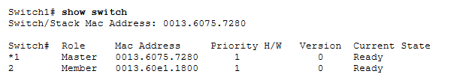

Verifying StackWise
You can verify the status of your stack by using the show switch command with different parameters.

Slide 12
What Is VSS?
Virtual Switching System (VSS) is a network system virtualization technology that combines a pair of Catalyst 4500 or 6500 series switches into one virtual switch, increasing the operational efficiency, boosting nonstop communications, and scaling the system bandwidth capacity.
The VSS simplifies network configuration and operation by reducing the number of Layer 3 routing neighbors and by providing a loop-free Layer 2 topology.
In the campus switched architecture, VSS is usually deployed in the aggregation layer to avoid the redundancy to the access layer switches in case of the switch failure.

Slide 13
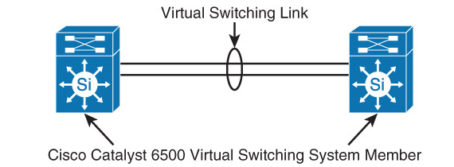
What Is VSS?
VSS is made up of two Catalyst switches and a virtual switch link (VSL) between them.
The VSL is made of up to eight 10 Gigabit Ethernet connections bundled into an EtherChannel.
VSL carries the control plane communication between the two VSS members, in addition to regular data traffic.
Once the VSS is formed, only the control plane of one of the members is active.
The data plane and switch fabric of both members are active.
Both chassis are kept in sync with the interchassis SSO mechanism, along with NSF to provide nonstop communication even in the event of failure of one of the member supervisor engines or chassis.

Slide 14
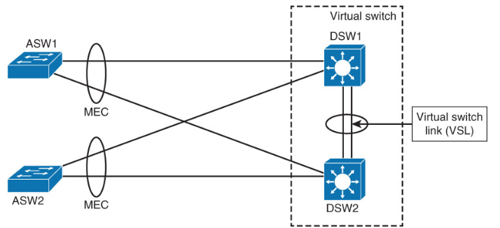
VSS Benefits
VSS increases operational efficiency by reducing switch management overhead and simplifying the network.
It provides a single point of management, IP address, and routing instance.
VSS can be managed with single management point from which you configure and manage the VSS.
Neighbors see the VSS as a single Layer 2 switching or Layer 3 routing node, thus reducing the control protocol traffic.

Slide 15
VSS Benefits
VSS provides a single VLAN gateway IP address, removing the need for the first-hop redundancy protocol (HSRP, VRRP, GLBP).
Multichannel EtherChannel (MEC) allows you to bundle links to two physical switches in VSS, creating a loop-free redundant topology without the need for STP.
Interchassis stateful failover results in no disruption to applications that rely on network state information (for example, forwarding table info, NetFlow, Network Address Translation, authentication, and authorization).
VSS eliminates Layer 2 / Layer 3 protocol reconvergence if a virtual switch member fails, resulting in deterministic subsecond virtual switch recovery.

Slide 16
Verifying VSS
To verify the status of VSS configuration, use the following show switch virtual commands with various parameters:
show switch virtual
show switch virtual link
show switch virtual role
show switch virtual link port-channel

Slide 17
Redundant Switch Supervisors
The Cisco supervisor engine module is the heart of the Cisco modular switch platforms. The supervisor provides centralized forwarding information and processing. All software processes of a modular switch are run on a supervisor.
Redundant supervisors are highly recommended for the aggregation and core layer so that they might help provide faster convergence in case of the primary supervisor failure.
Platforms such as the Catalyst 4500, 6500, and 6800 series can accept two supervisor modules that are installed in a single chassis, thus removing a single point of failure. The first supervisor module to successfully boot becomes the active supervisor for the chassis. The other supervisor remains in a standby role, waiting for the active supervisor to fail.
The active supervisor provides all switching functions. The standby supervisor, however, is allowed to boot and initialize only to a certain level. When the active module fails, the standby module can proceed to initialize any remaining functions and take over the active role.

Slide 18
Supervisor Redundancy Modes
Route processor redundancy (RPR): The redundant supervisor is only partially booted and initialized. When the active module fails, the standby module must reload every other module in the switch and then initialize all the supervisor functions.
Route processor redundancy plus (RPR+): The redundant supervisor is booted, allowing the supervisor and route engine to initialize. No Layer 2 or Layer 3 functions are started. When the active module fails, the standby module finishes initializing without reloading other switch modules. This allows switch ports to retain their state.
Stateful switchover (SSO): The redundant supervisor is fully booted and initialized. Both the startup and running configuration contents are synchronized between the supervisor modules. Layer 2 information is maintained on both supervisors so that hardware switching can continue during a failover. The state of the switch interfaces is also maintained on both supervisors so that links do not flap during a failover.

Slide 19
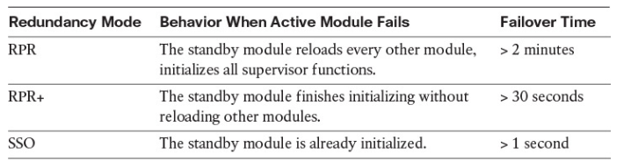
Supervisor Redundancy Modes

Slide 20
Nonstop Forwarding
NSF is an interactive method that focuses on quickly rebuilding the Routing Information Base (RIB) table after a supervisor switchover.
The RIB is used to generate the Forwarding Information Base (FIB) table for CEF, which is downloaded to any switch modules that can perform CEF.
Both the Catalyst 4500 and 6500 family supports this feature.
Cisco NSF provides the following benefits:
Improved network availability: NSF continues forwarding network traffic and application state information so that user traffic is not interrupted after a supervisor switchover.
Overall network stability: Network stability is improved by maintaining routing protocol neighbor relationships during supervisor failover.

Slide 21


